Slide 1
The way to a Career
Primary school
Otokara Březiny, Jihlava

Slide 2
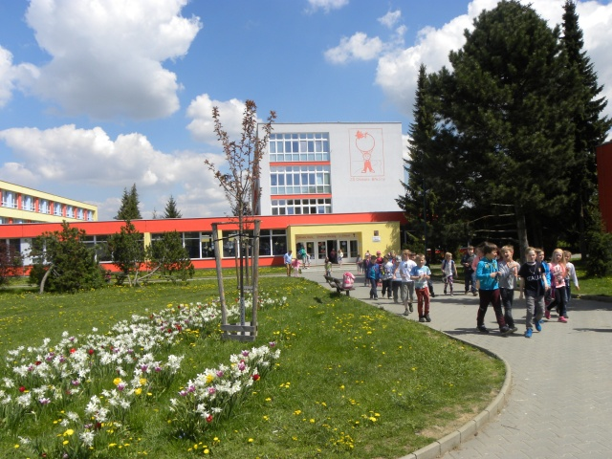
Primary school Otokara Březiny Jihlava

Slide 3
Development of Competencies
Key activities for pupils :
CRAFTS – years 4 and 5
THE WORLD OF WORK– years 6 and 7
MY CAREER– years 6 to 9

Slide 4
Learning Competencies
To motivate interest in lifelong learning
To create meaningful learning
To develop a positive attitude to learning
To have continual assessment of the childs progress
To arrange a critical evaluation of results

Slide 5
Learning Competencies
The portfolios Crafts

Slide 6
Competencies. Solution to the Problems
To activate creative thinking
To consider making the right decisions
To defend their own opinions
To organize competitions, exhibitions and presentations

Slide 7
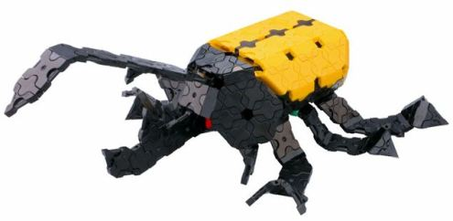
Competencies. Solution to the Problems
Kits
The interests
25%
25%
50%

Slide 8
The competencies required of the individual citizen
To be free and responsible for making correct decisions
To understand their rights and duties
To understand social norms and rules
The support of the school, the family and of the general public

Slide 9
The competencies required of the individual citizen
My career– 6. year – I and the world around me

Slide 10
Competencies. Social and personal
To develop the ability to cooperate together
To show respect for their own work and the work of others
To be able to create new rules and to respect those rules
To develop a positive attitude to work and to understand what quality means

Slide 11
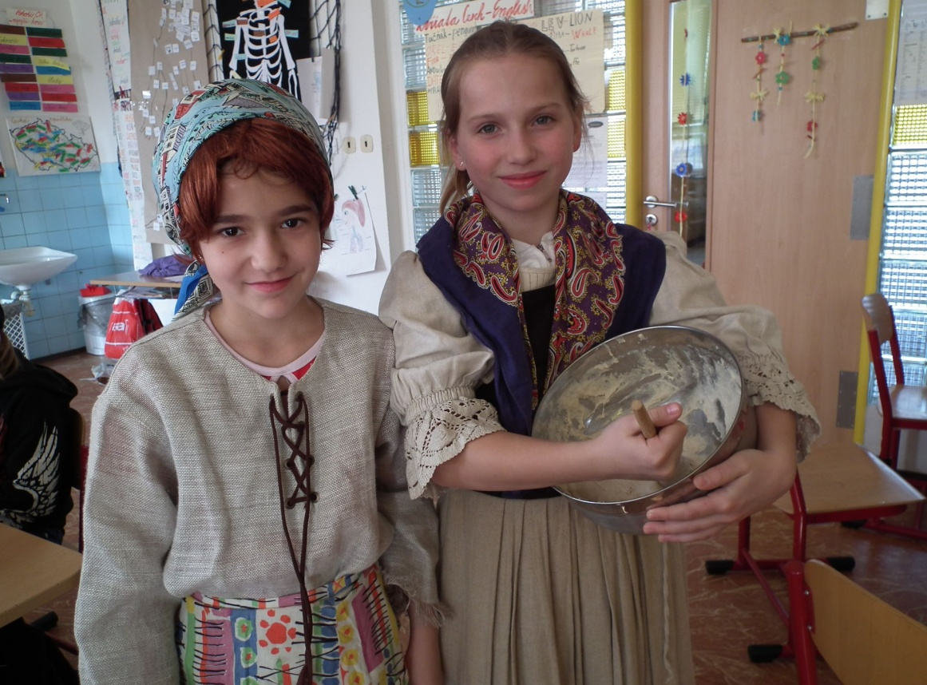
Competencies. Social and Personal
Crafts - Baking Bread

Slide 12
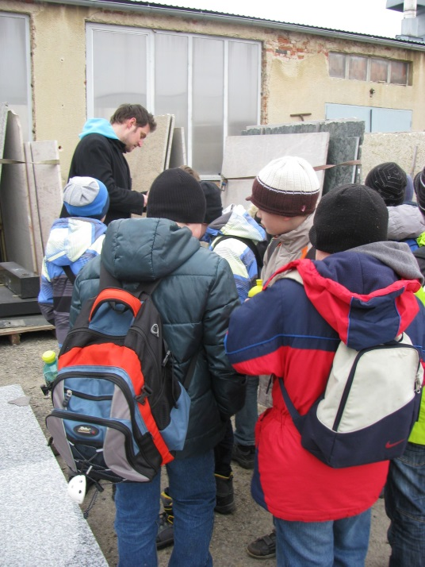
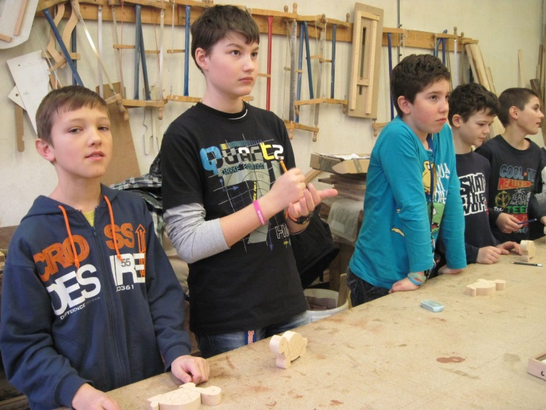
Excursions
Companies
Secondary schools

Slide 13
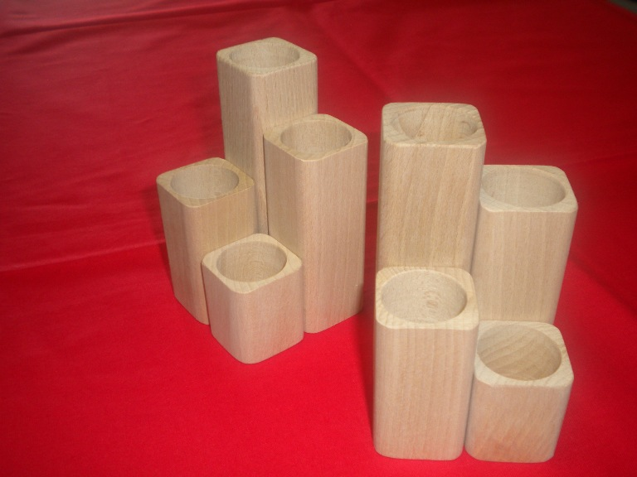
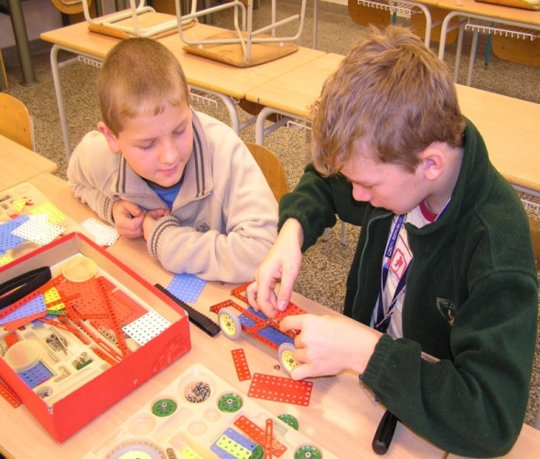
Working Competencies
To develop a professional attitude
To follow the rules
To be able to work with different types of materials
To be able to use a variety of tools

Slide 14
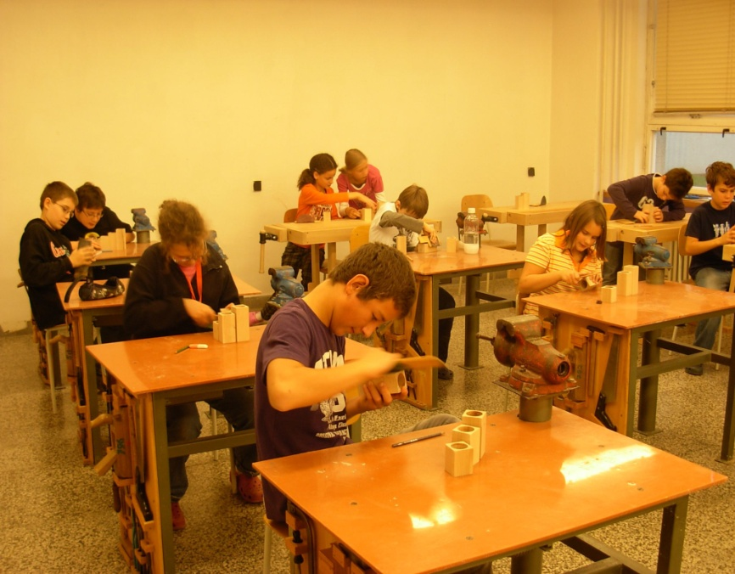
Working Competencies
Practical experince Year 6
Crafts Year 4

Slide 15
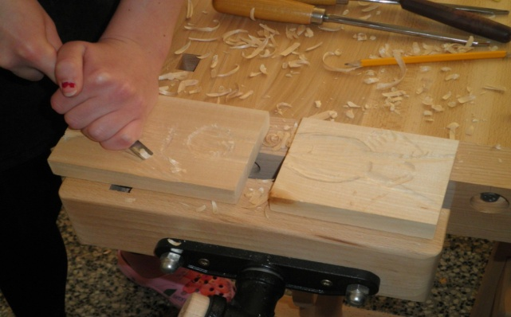
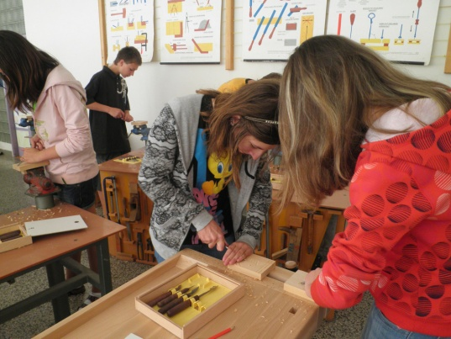
Wood carving hobby group

Slide 16
Communicative Competencies
To promote effective communication
To use appropriate and correct professional expressions
To use information technologies
To communicate with the world through the use of foreign languages

Slide 17
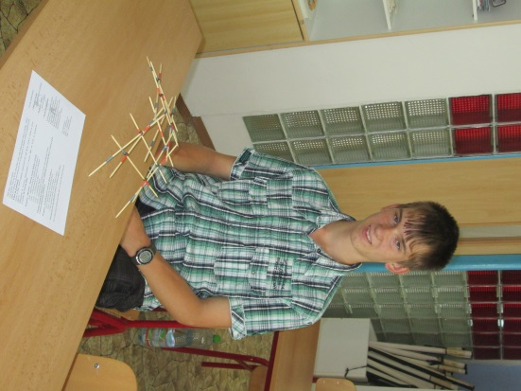
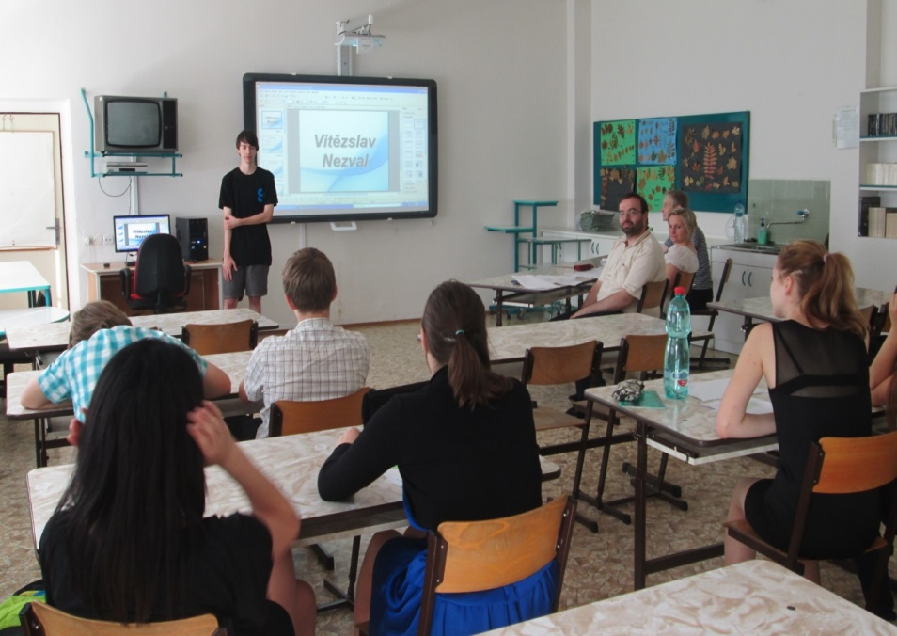
Communicative Competencies
Seminar work in the year 9

Slide 18
Contribution of the Project. Way to a career
To develop key competencies in pupils
To develop the skills of the teachers
To update the schools curriculum
To develop the provision of modern information technology
To encourage the promotion of the school

Slide 19
Way to a Career
The project was co-financed by the European Social Fund and the state budget of the Czech Republic

Slide 20
Thank you for your attention
Mgr. Pavel Říha
Headmaster
Primary school
Otokara Březiny, Jihlava

