Slide 1
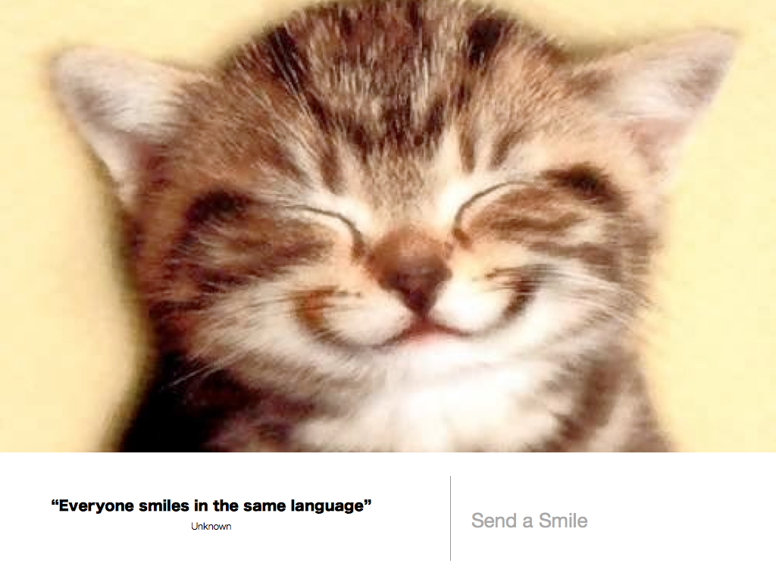

Slide 2
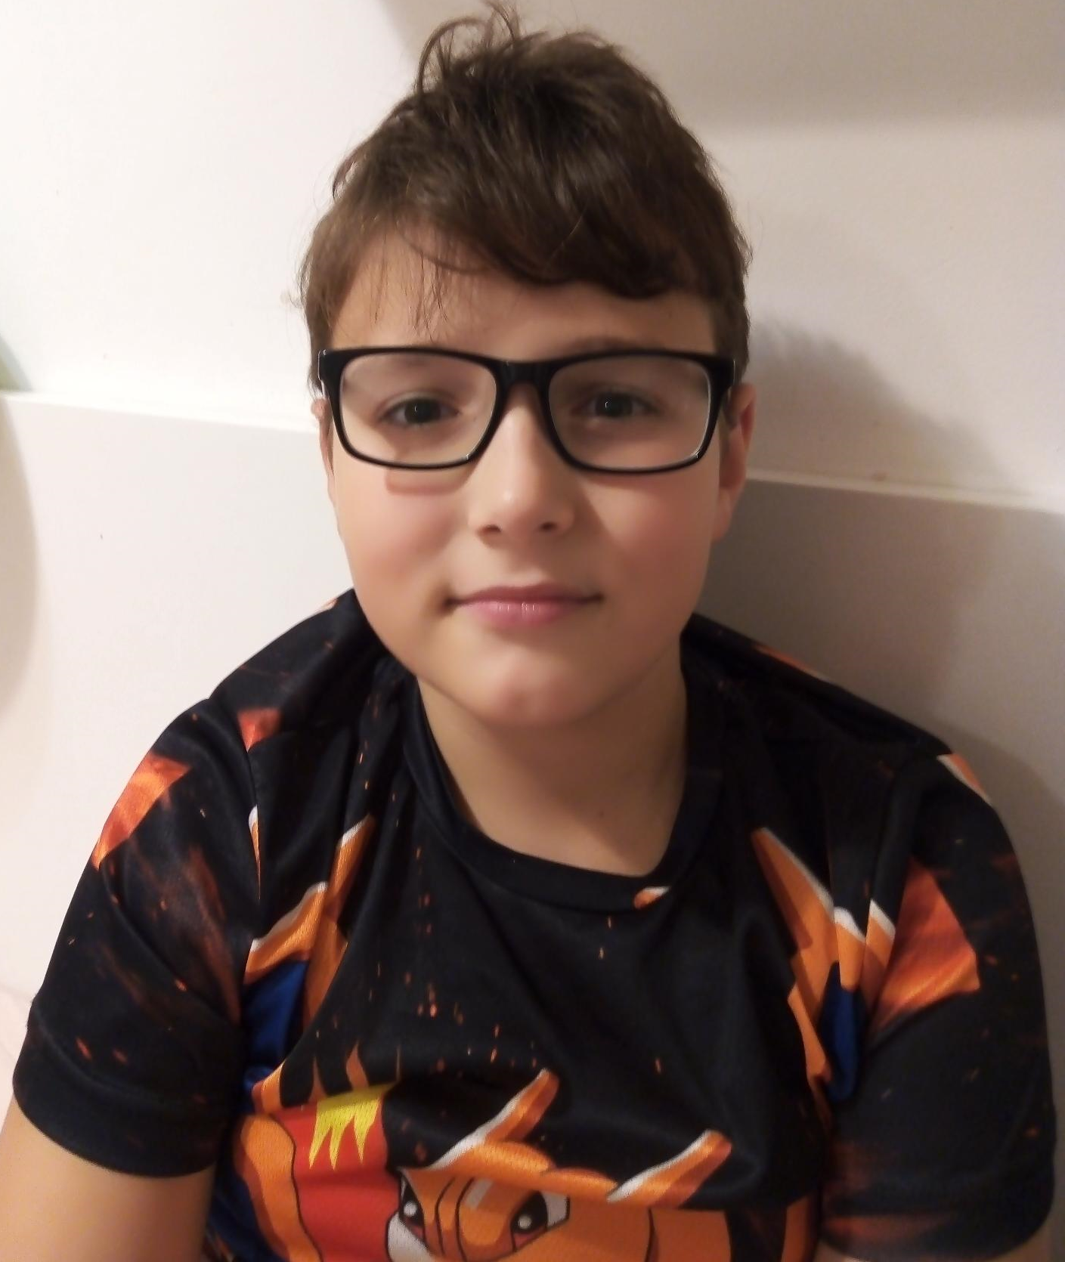
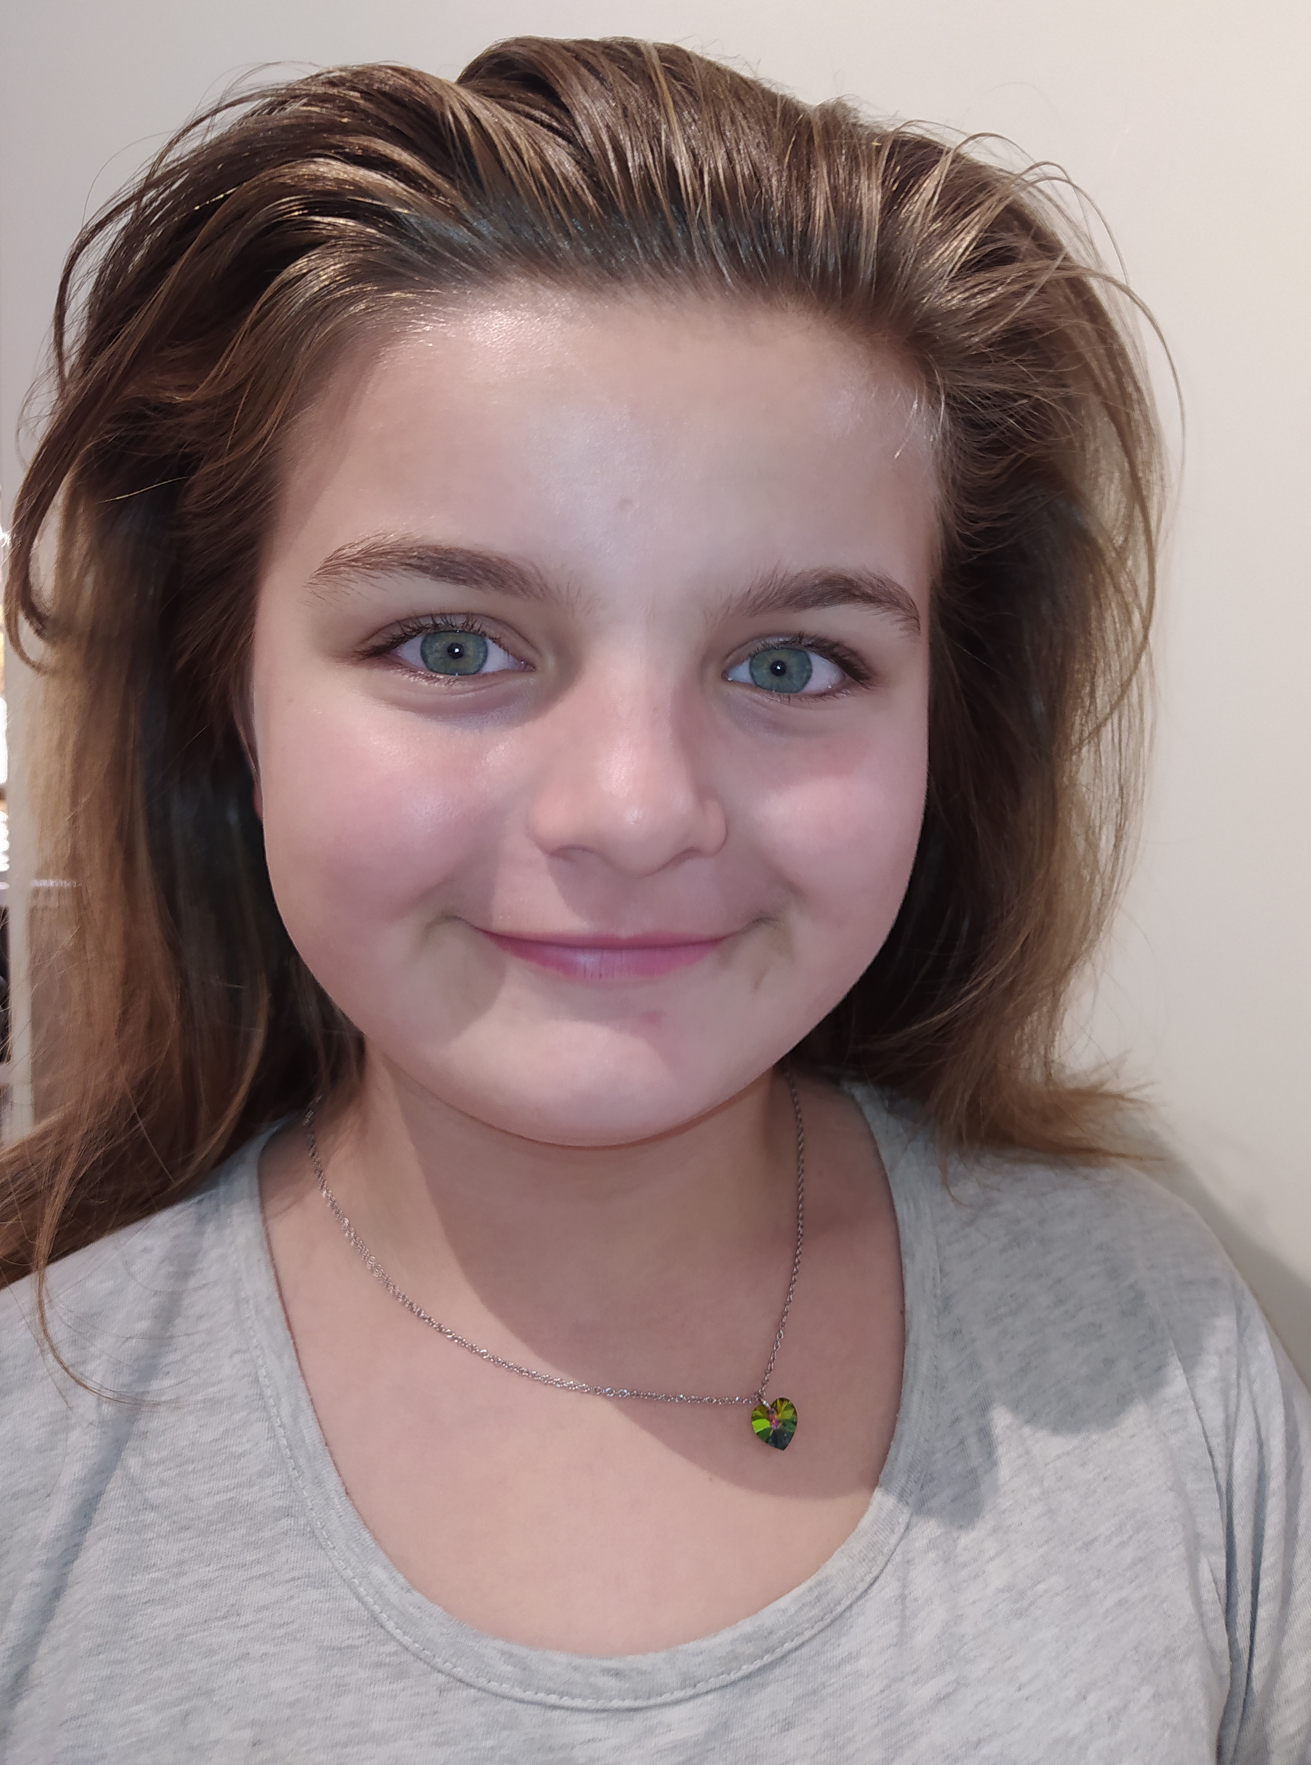
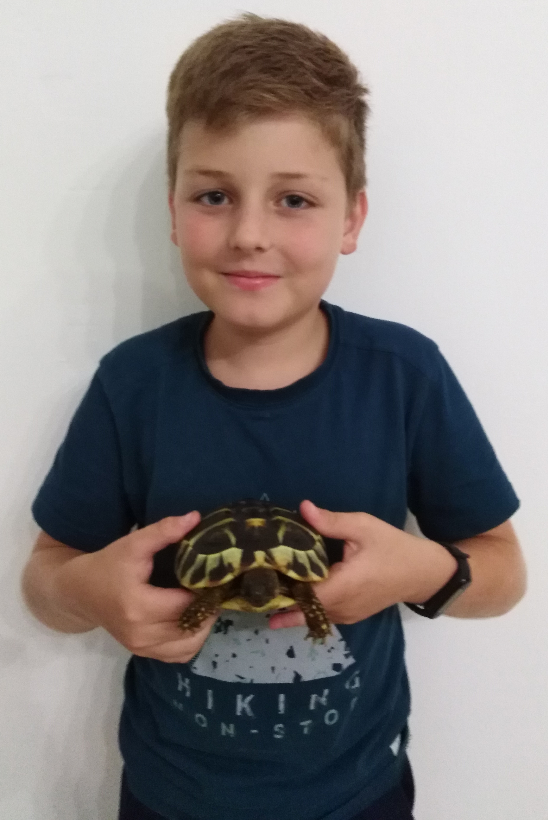
Hello! We are friends from one English class.
This is the team of our chief reporters.
My name is Denisa. Im ten years old. I'm from Jihlava and I live in the Czech Republic. My favourite animal is a horse. I go to school Otokara Březiny. I have one sister and one brother. She is twelve years old and my brother is one year old.
My name‘s Jindra, but my English friends call me „King Henry“. I‘m a boy ☺ I‘m nine years old. I‘m big and smart. I have a big family – I have two sisters, mum and dad.
I‘m 9 years old. I like to play football. I live in Jihlava. I‘ve got one sister.

Slide 3
I'm big, I'm small.
I'm short, I'm tall.
I'm happy, I'm sad.
I'm good, I'm bad.
We are friends, that's the end.
Read about our friends and have fun.

Slide 4
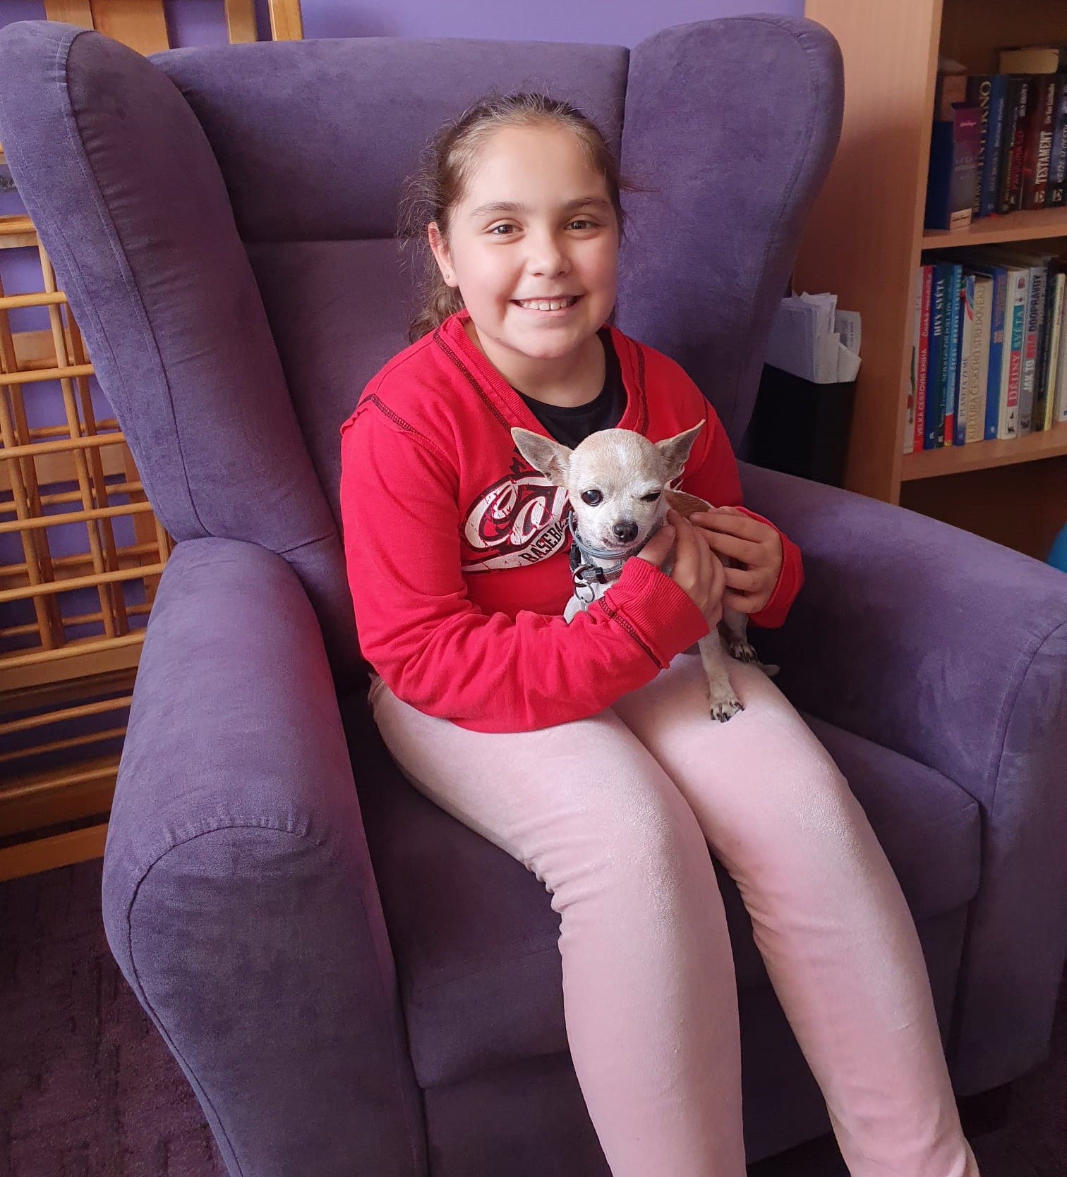
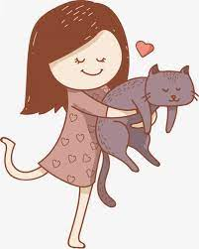
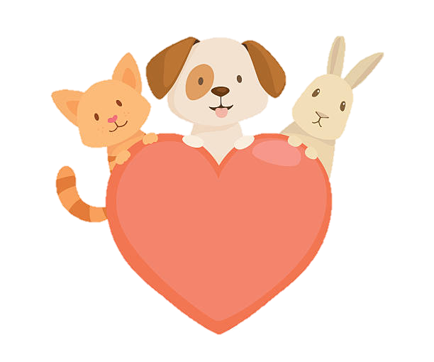
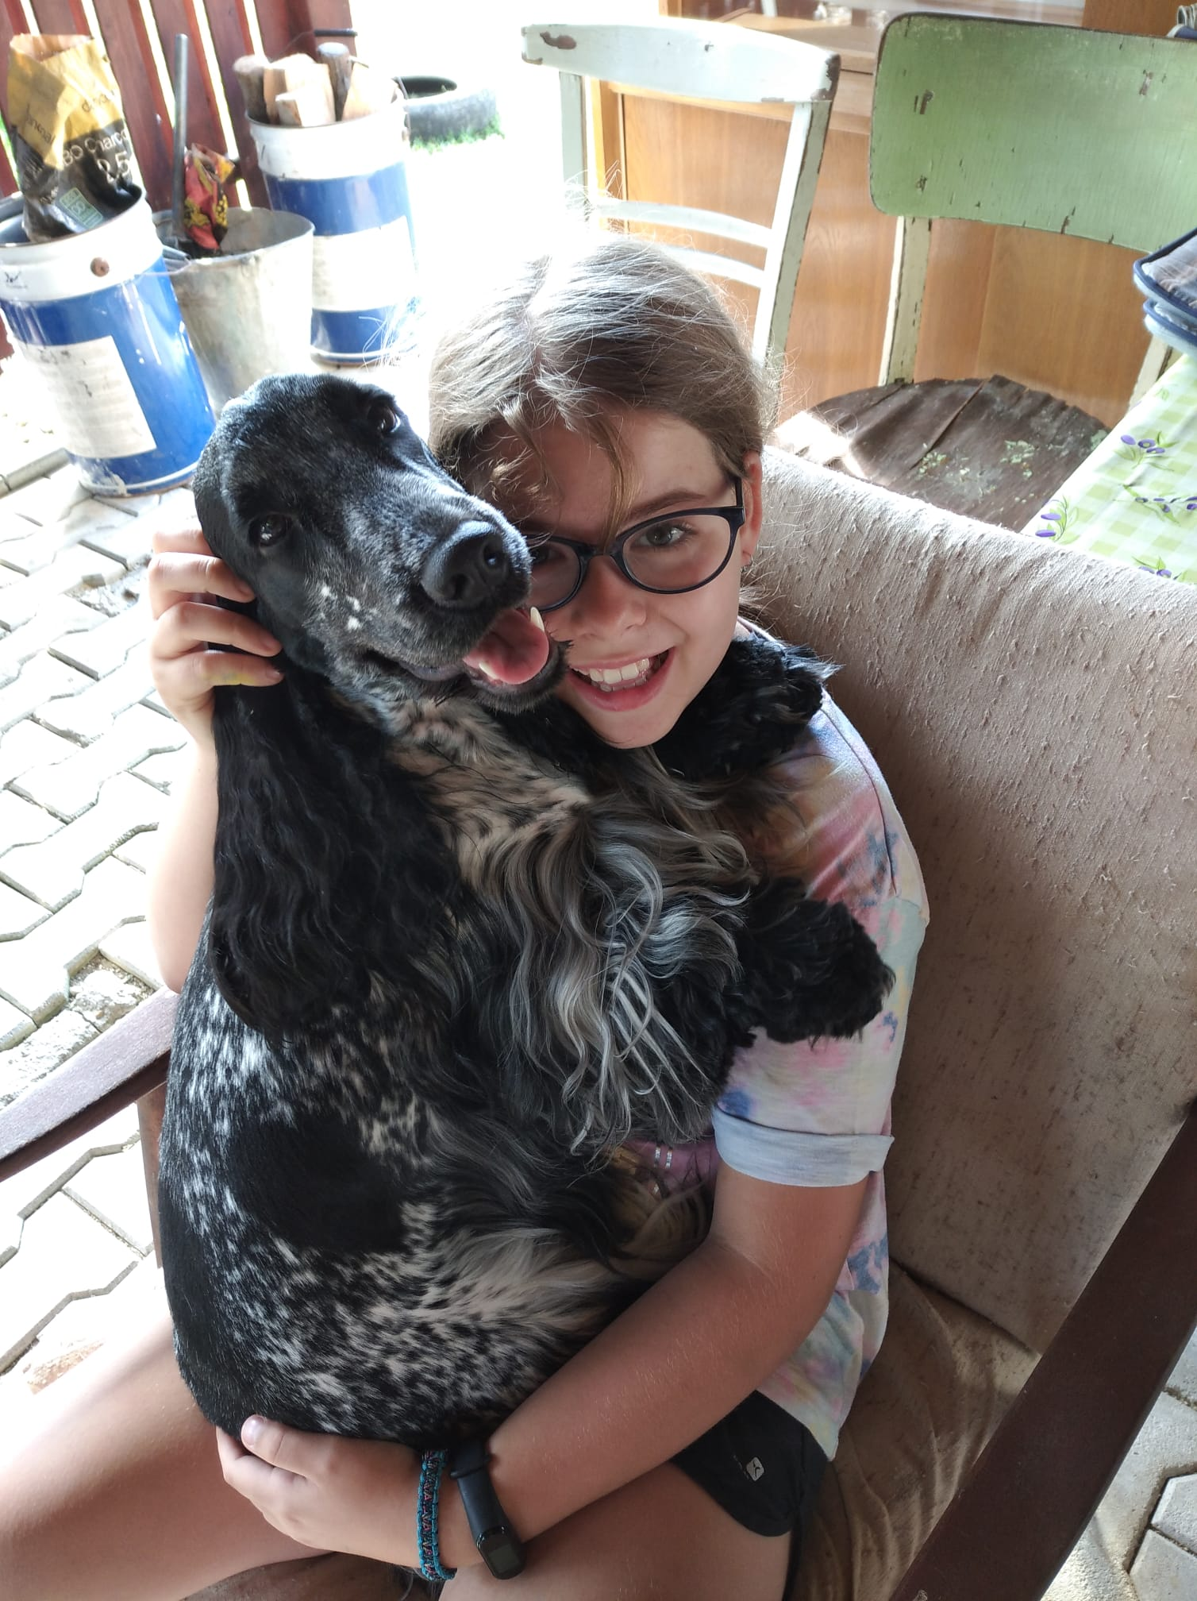
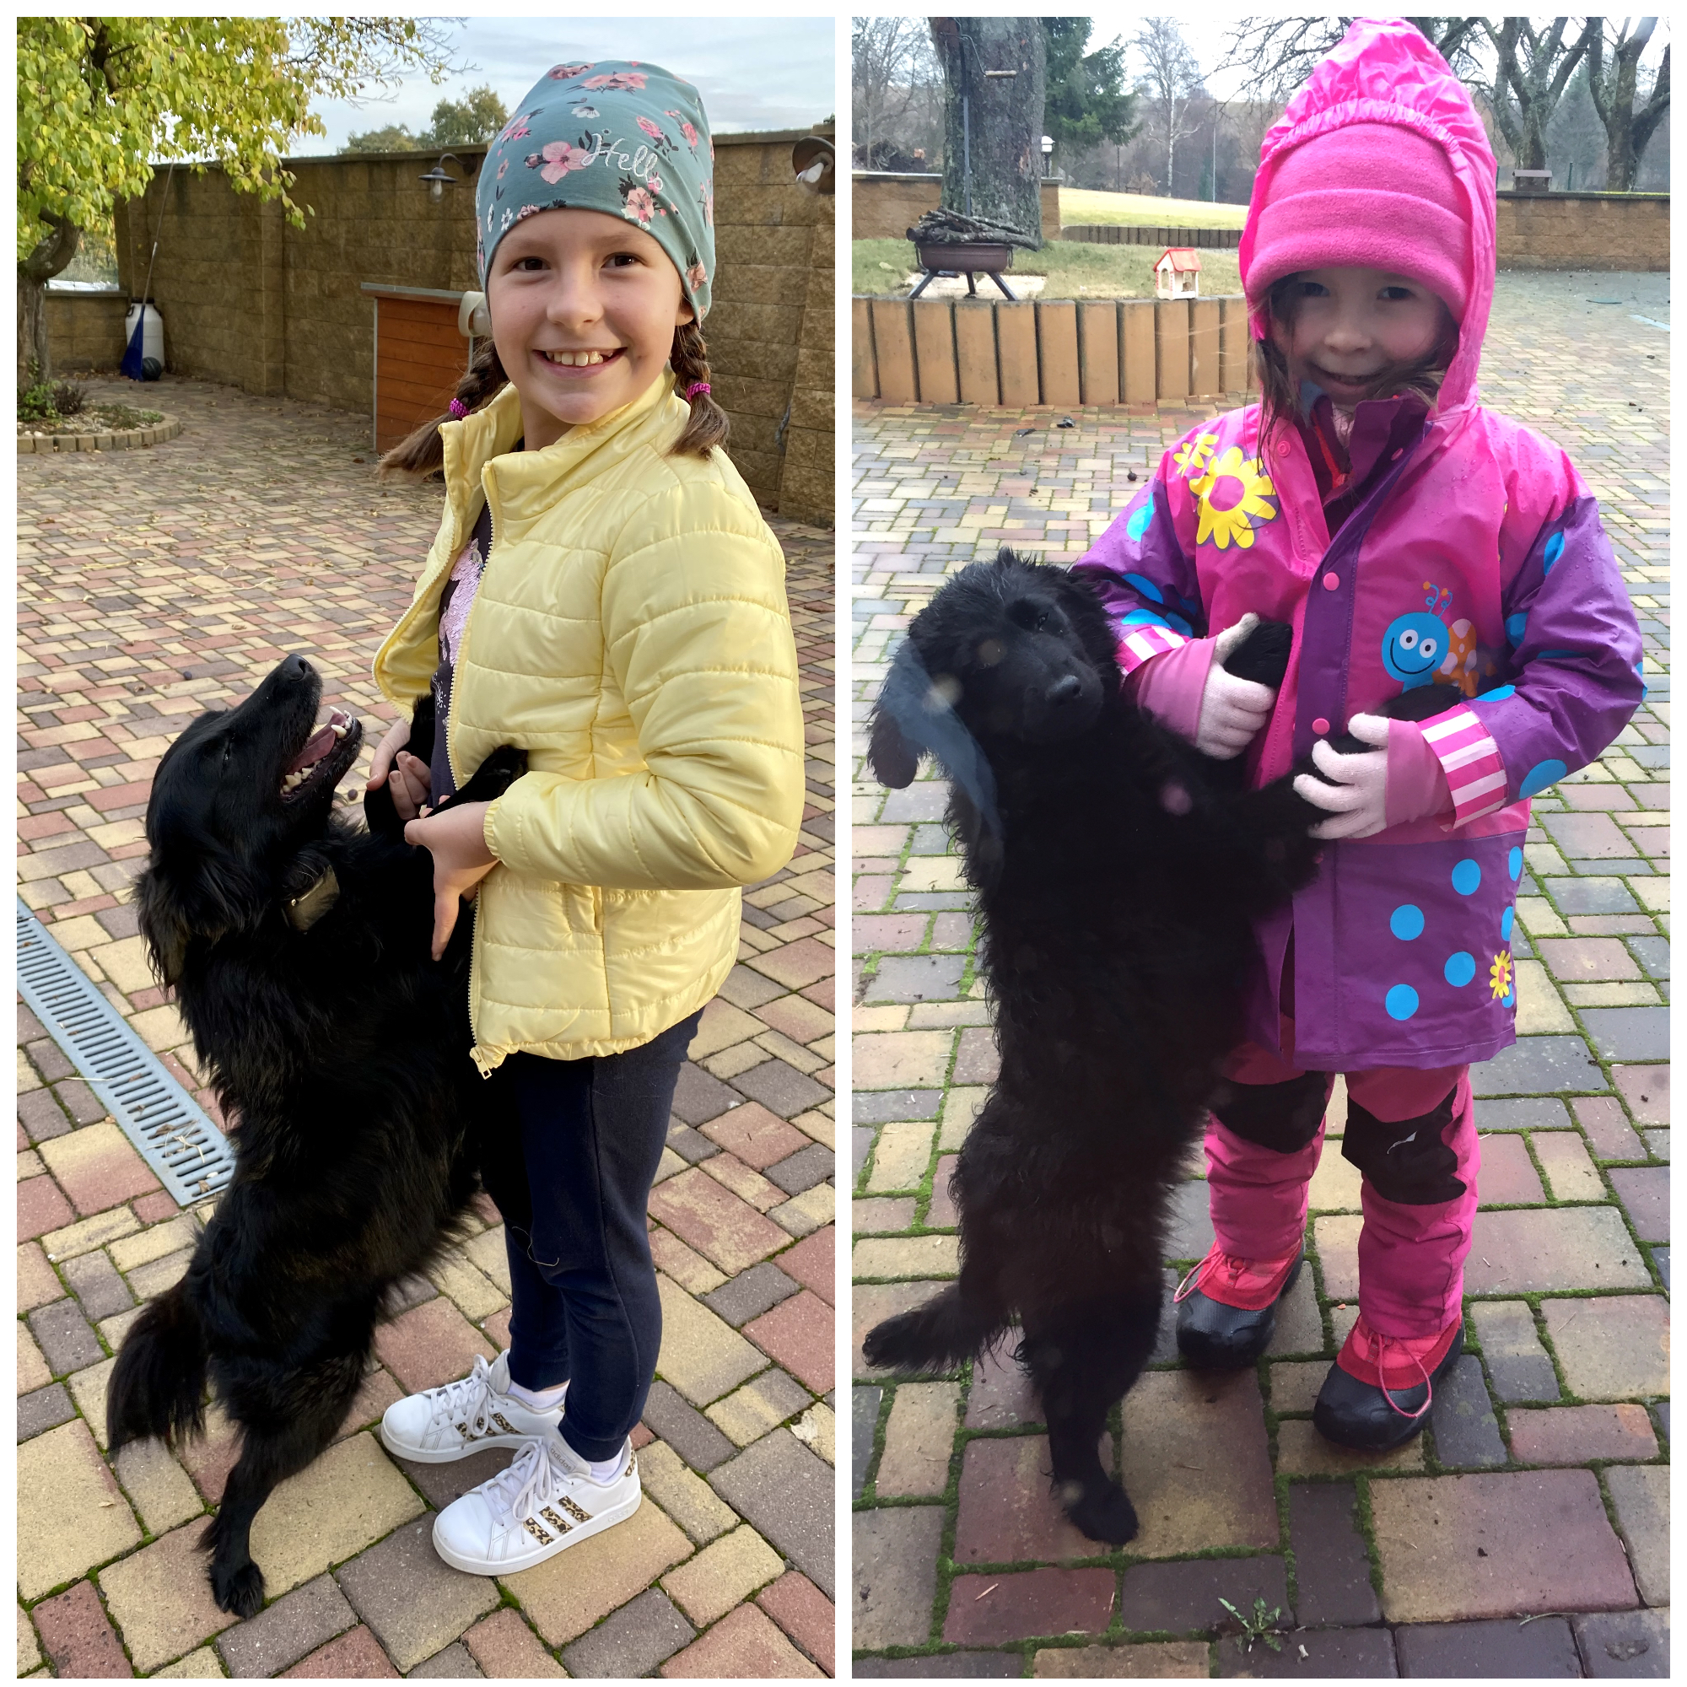
My name is Eva Mendez. I am nine years old . I was born in Mexíco. Now i live in Czech Republic in Jihlava. I have the younger brother Kristian. I goto school Březinova. I love my school. I have the best teacher of English.
My name is Klára. I´m 10 years old. I like to play basketball. I love cats. I´m tall. I´ve got long brown hair. I´ve got one sister. I´m from the Czech Rapublic.I go to class 4.A.
Hello, my name's Barbora. I'm 9 years old. I live in Jihlava. I've got a dog. His name is Rony. I love him.

Slide 5
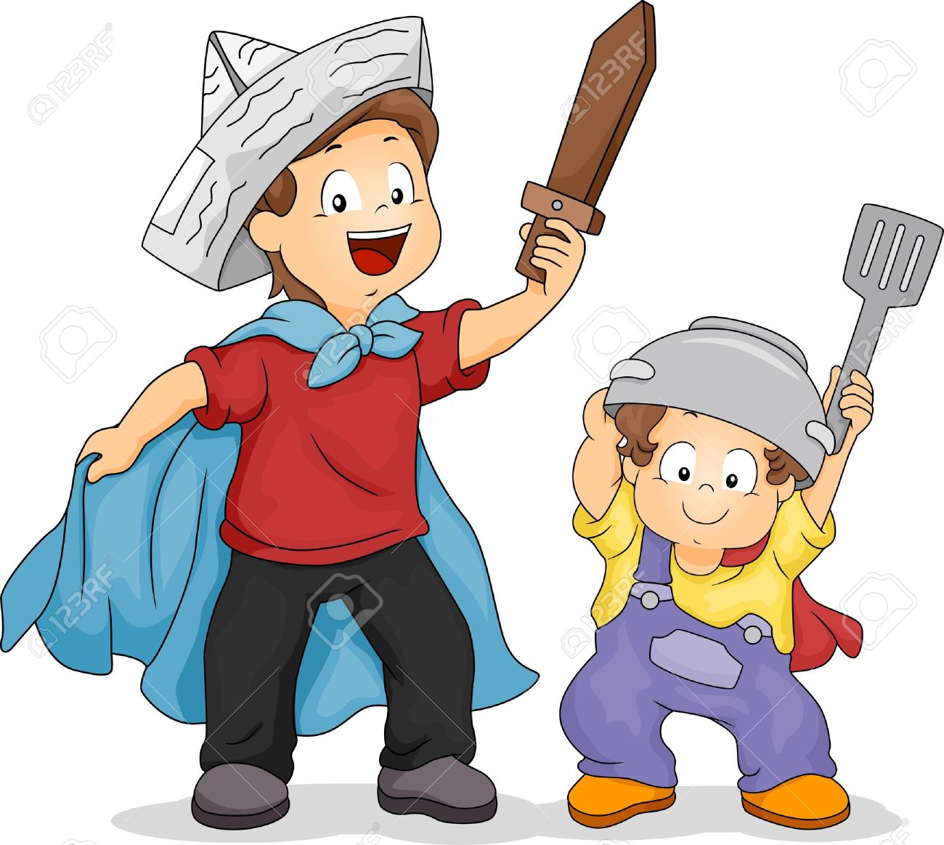
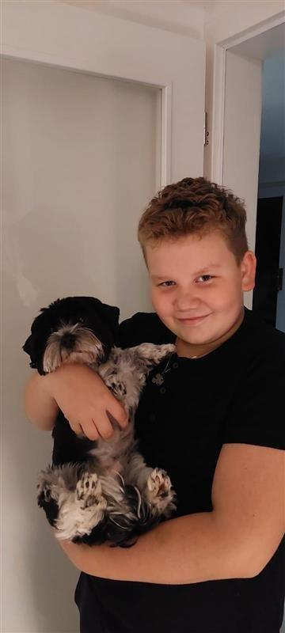
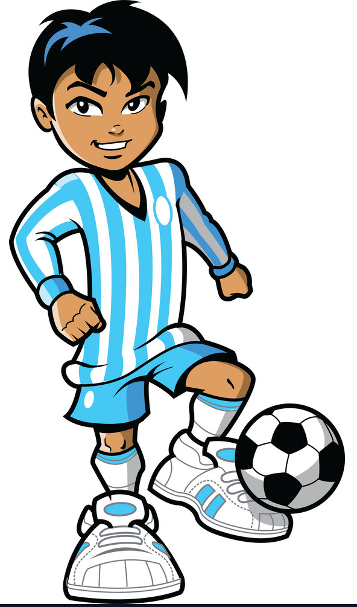
MY NAME IS MIKY.
I´M FROM THE CZECH REPUBLIC.
I'M TEN YEARS OLD. I HAVE A SISTER, HER NAME IS NIKOLKA. I HAVE A DOG – IT IS TWO YEARS OLD. I LIKE SUSHI, PIZZA, STEAKS AND I DON'T LIKE SEAFOOD.
Hello I'm Dan. I'm ten years old. I haven't got a pet. I like to read books and play with my brother.
Hello my name is Matyas Bartak. I'm ten years old. I like to play football. I love dogs. My friends call me Maty. I'm friendly.
I've got short, hair and blue eyes. I´ve got one brother. I'm from the Czech Republic. I go to class 4.A. Březinova school.
My name’s Kryštof.
I’m 10 years old. I go to class 4.B.
I like to create books. I like to read books, ride a bike and a skateboard.
I can play the piano.
My friends call me Kryštof. I’m funny.
I’ve got short light brown hair and blue eyes.
I’ve got one sister.
I love cats and I’ve got a hamster.
His name is Kurt.
I’m from the Czech Republic.

Slide 6
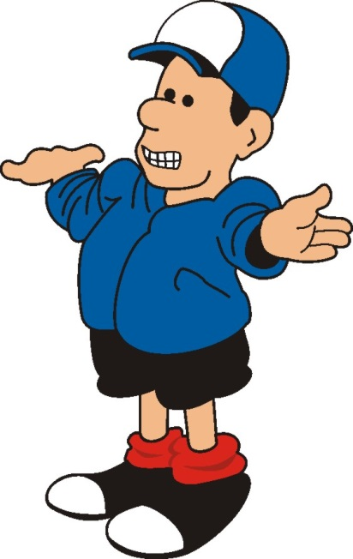
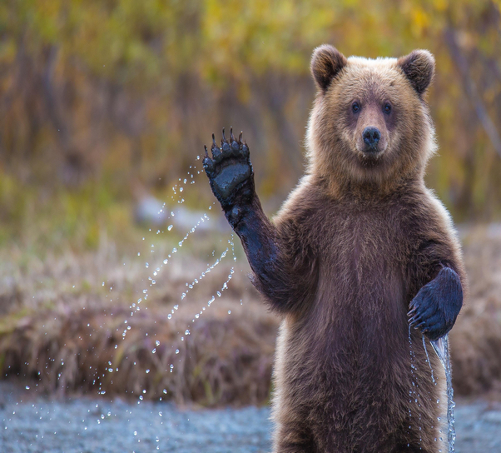
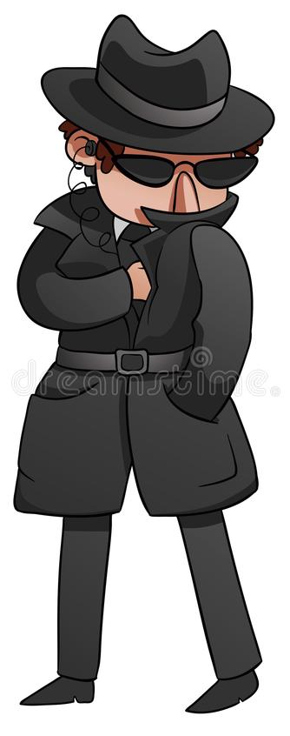
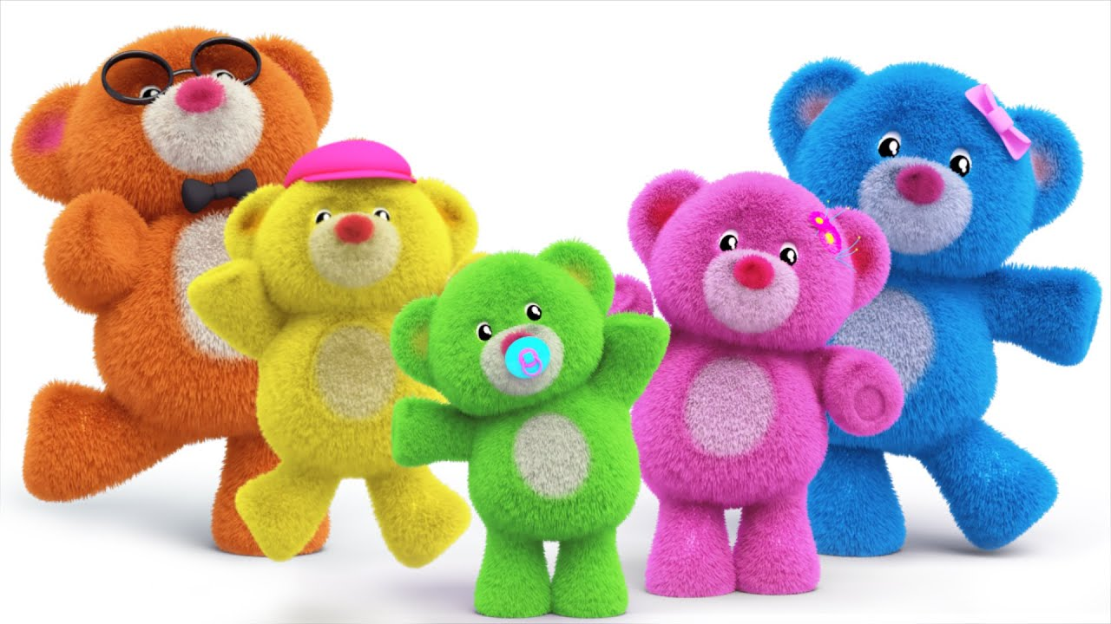
My name is Dany. I´m a boy. I´m 9 years old. I play football. I like Mathematics.
My name’s Looky. I’m nine.
I like to jump on the trampoline and I play tennis.
I love animals. I’ve got a cat. His name is Woody.
My friends call me Looky because I’m funny.
I can speak French - bonjour
I’ve got long brown hair.
I’ve got one sister.
I’m from the Czech Republic.
I go to class 4.C
My name’s Táda. I’m
9 years old. I like play football. I love small bears. My
friends call me
Mr. Teddy bear.
I’m fast. I’ve got a
long body. I’ve got 1 brother. I’m from the Czech Republic. I go to class 4.C in Březinova school.

